Slide 1
QA- Inventory Management System
A guide by Esperanza Cardenas

Slide 2

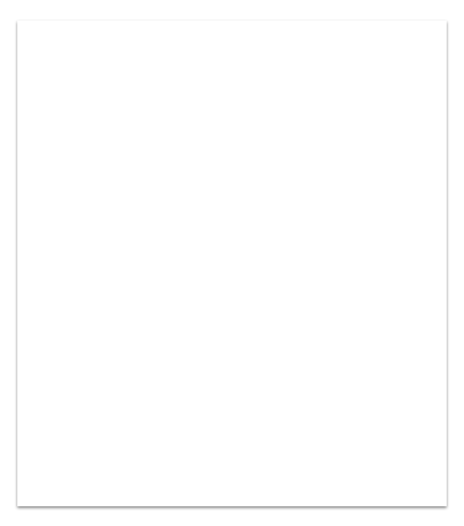
Overview
This project was created to manage an IMS using CRUD functionality
What I did well - Implementing the Items classes and unit testing.
Challenges- Implementing the Order classes was challenging when figuring out how to link items to the order.
Improvements- I would have liked to add a method to read the order Id, customer’s name as well as the item name in the order.

Slide 3
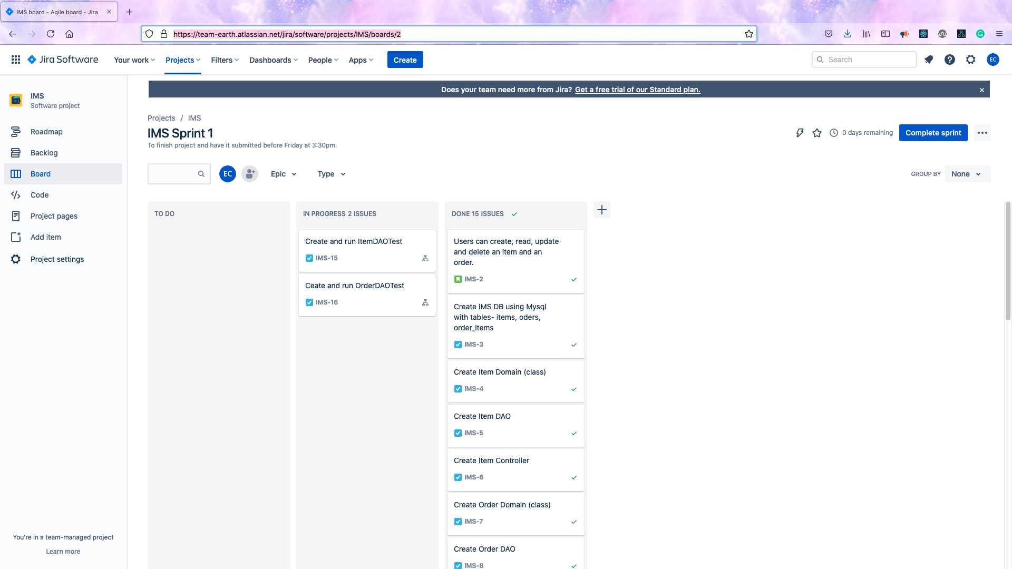
Jira Board
Used to track agile project workflow.
https://team-earth.atlassian.net/jira/software/projects/IMS/boards/2

Slide 4
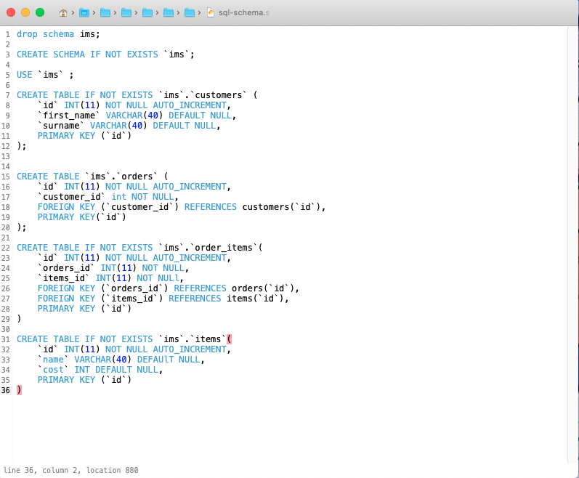
Database -
The IMS data base was written in SQL, this was easy enough to implement. It utilizes Primary and Foreign Keys to connect the Customer, Item, Orders, and Order_Items tables.

Slide 5
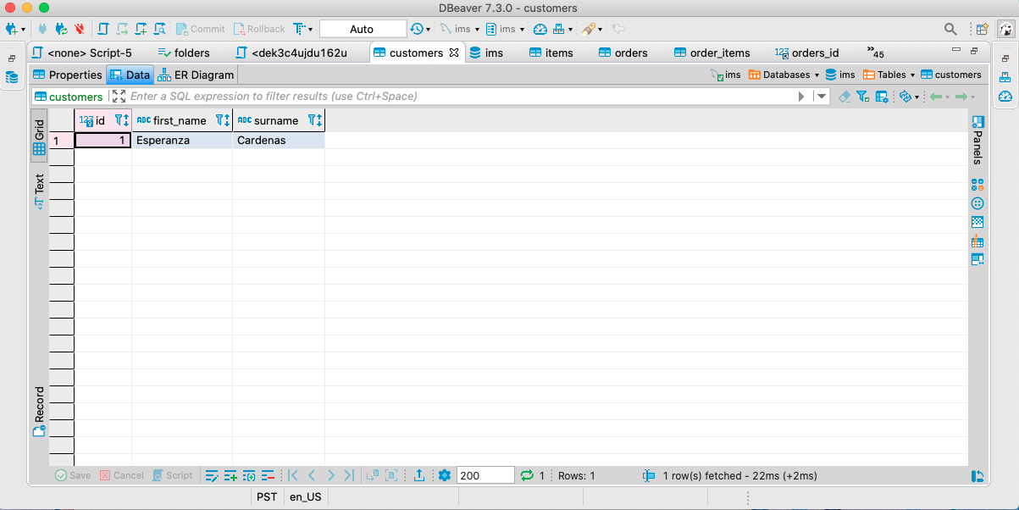
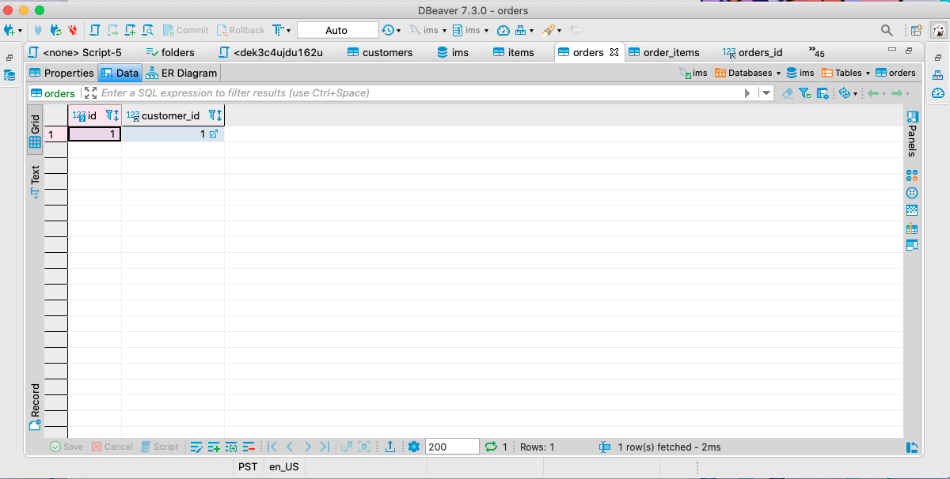
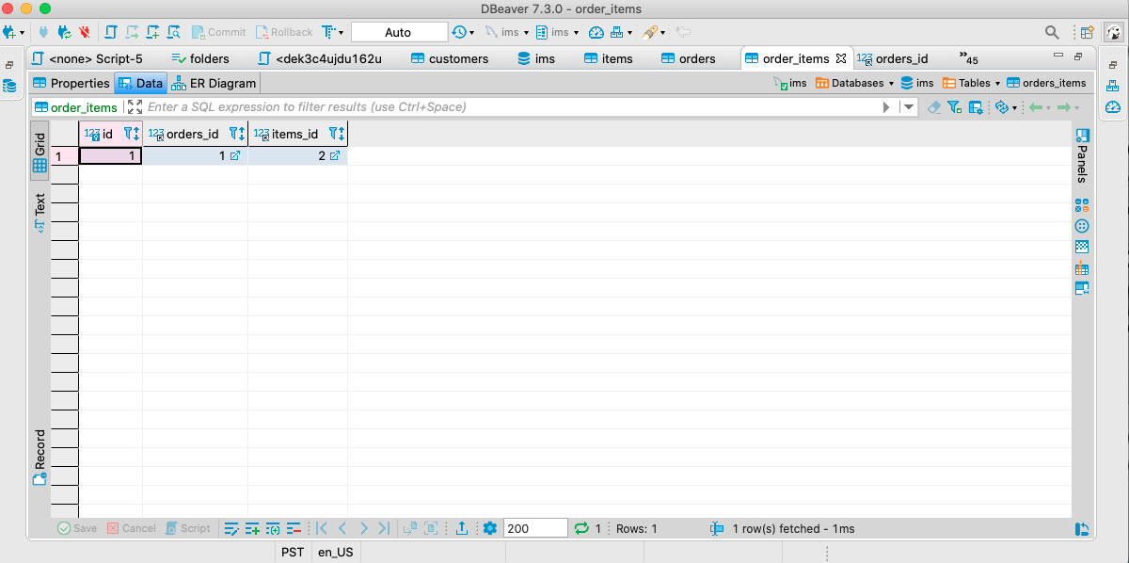
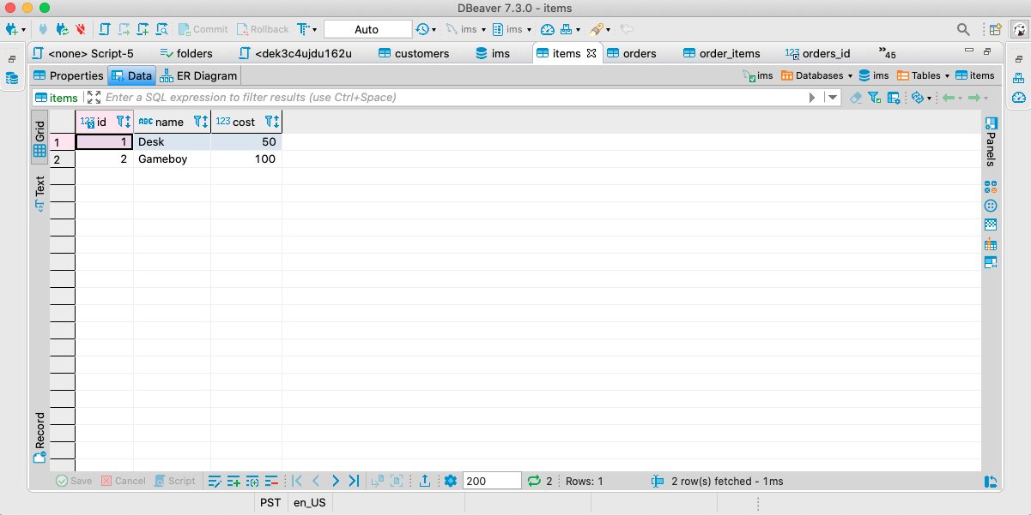
Database Tables continued

Slide 6
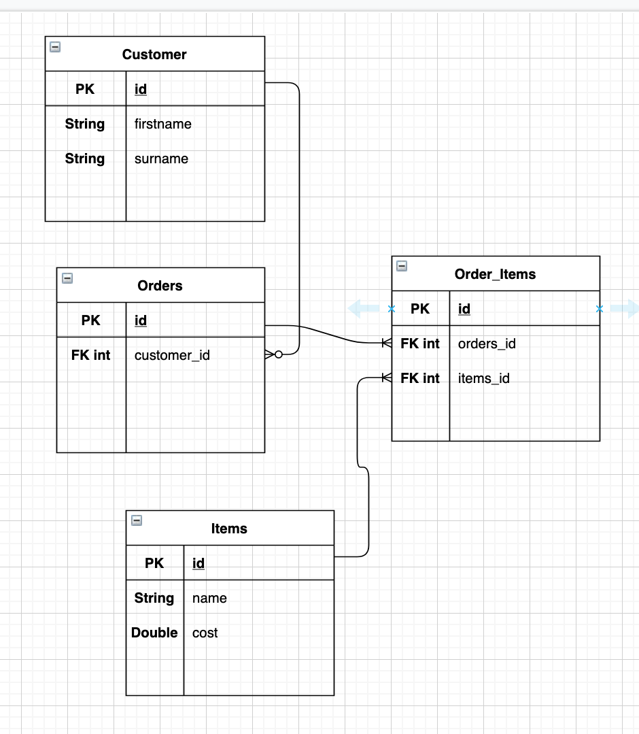
IMS ERD
An Entity-Relationship Diagram (ERD) is a type of abstract data model.
When used in the context of a database, an ERD maps out the relationships between tables.
Customer primary key Id has a 0 to many relationship with the foreign key(customer_id) because a customer can have many orders.
Orders id has a 1 to many relationship with order_items FK orders_id,
Items PK id has a 1 to many relationship with Order_items FK items_id

Slide 7
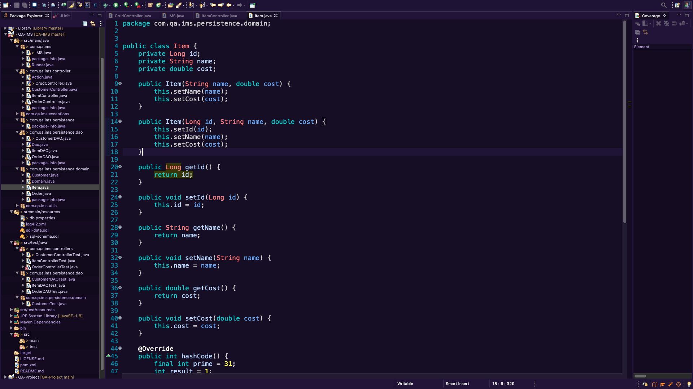
Item Domain -
The Item domain is the class instance of our item’s table, This was easy to create following the Customer domain as a guideline, I really appreciate Eclipses auto-generated getters and setters.
Story for illustration purposes only

Slide 8
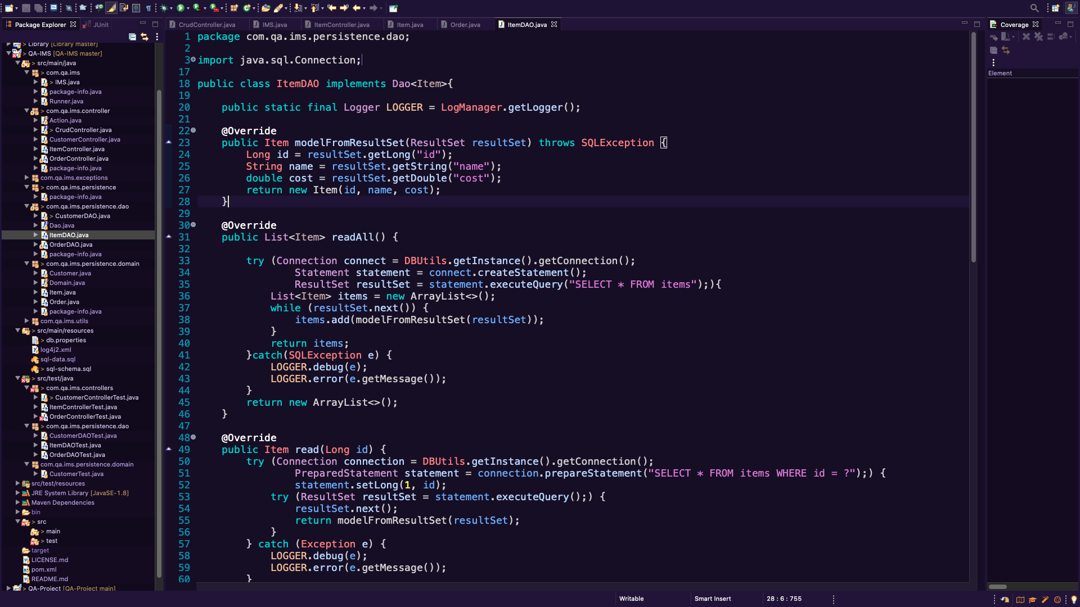
Item DAO-
The Item data access object manipulates the Item Domain(class) & interacts with the database.

Slide 9
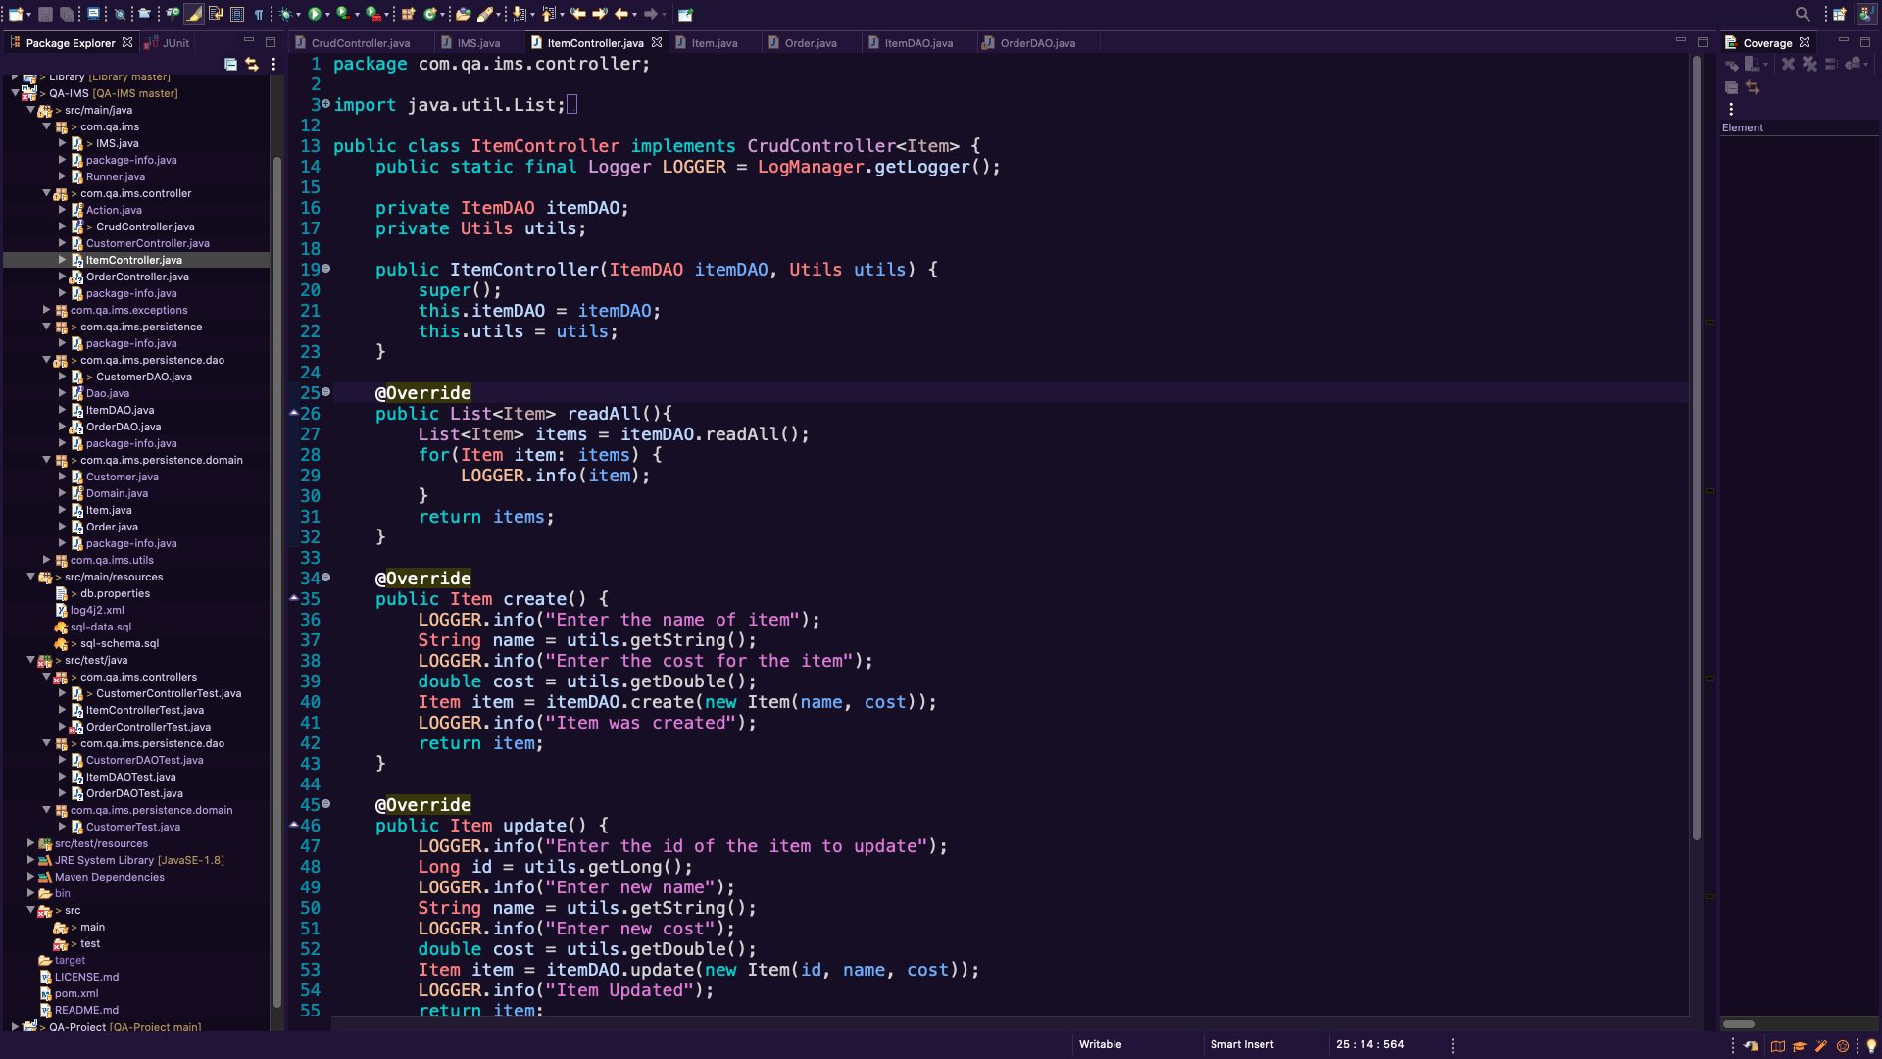
Item Controller-
The Item controller interacts with the user and manipulates the DAO.

Slide 10
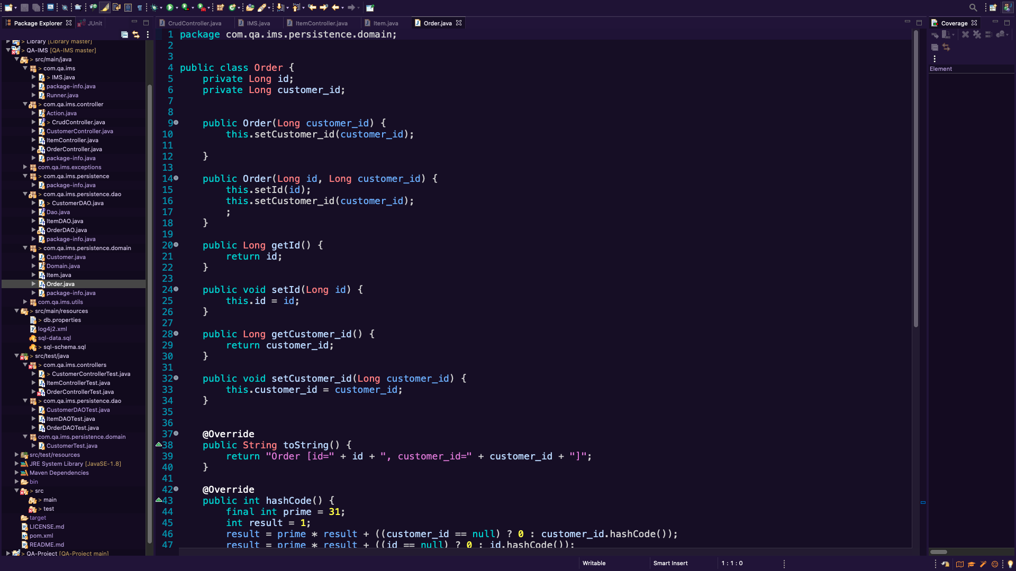
Order Domain
The Order domain is the class instance of our Order’s table, This was also easy enough to implement using auto-generated getters and setters.

Slide 11
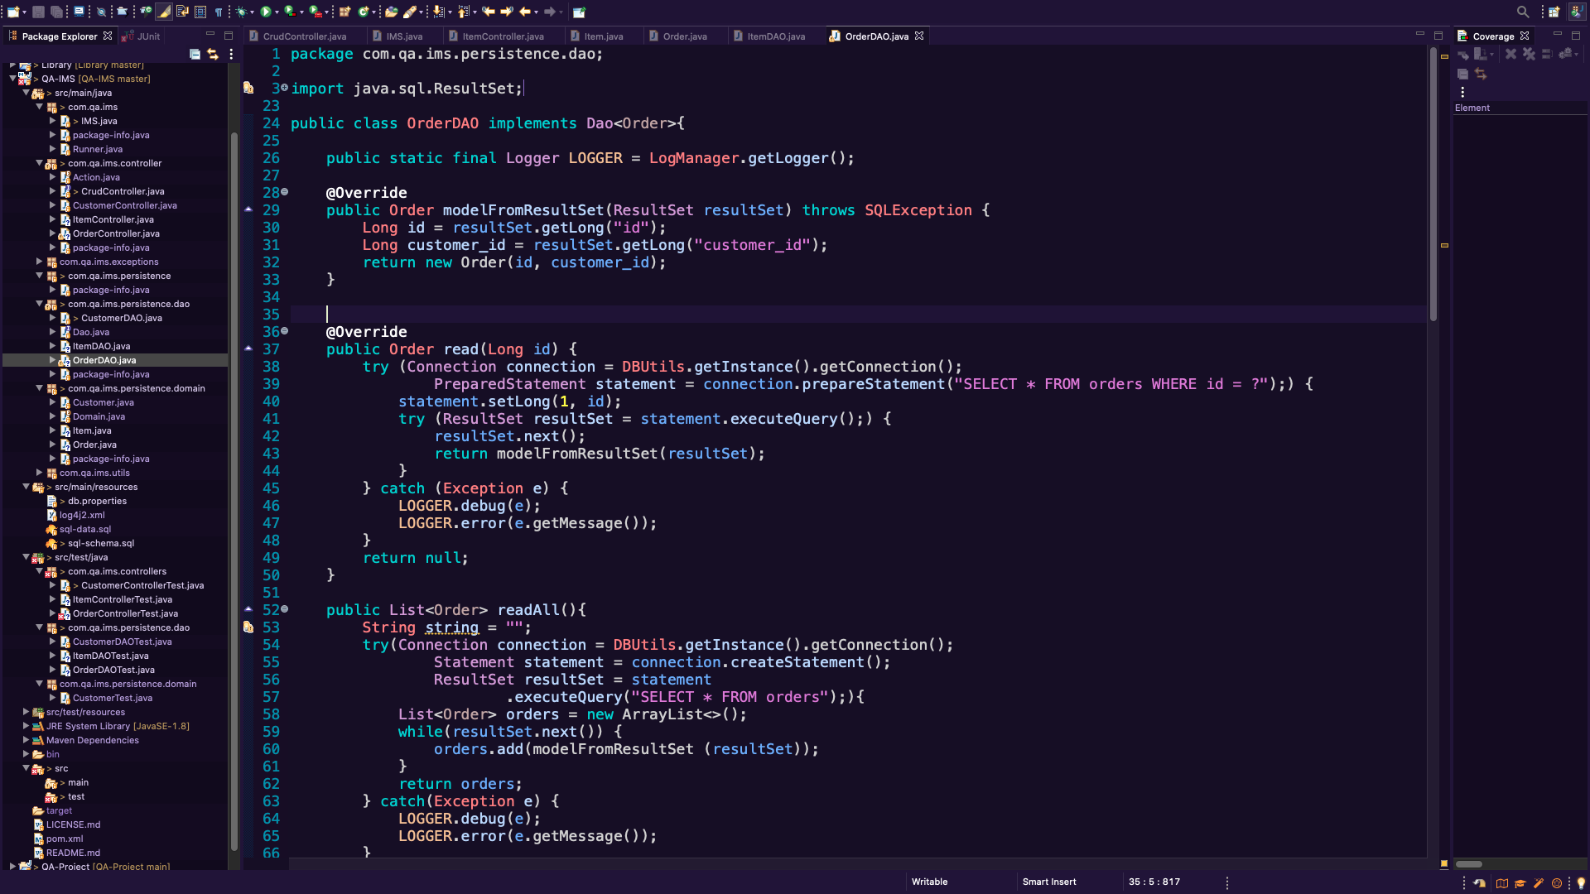
Order DAO
The Item data access object manipulates the Item Domain(class) & interacts with the database.

Slide 12
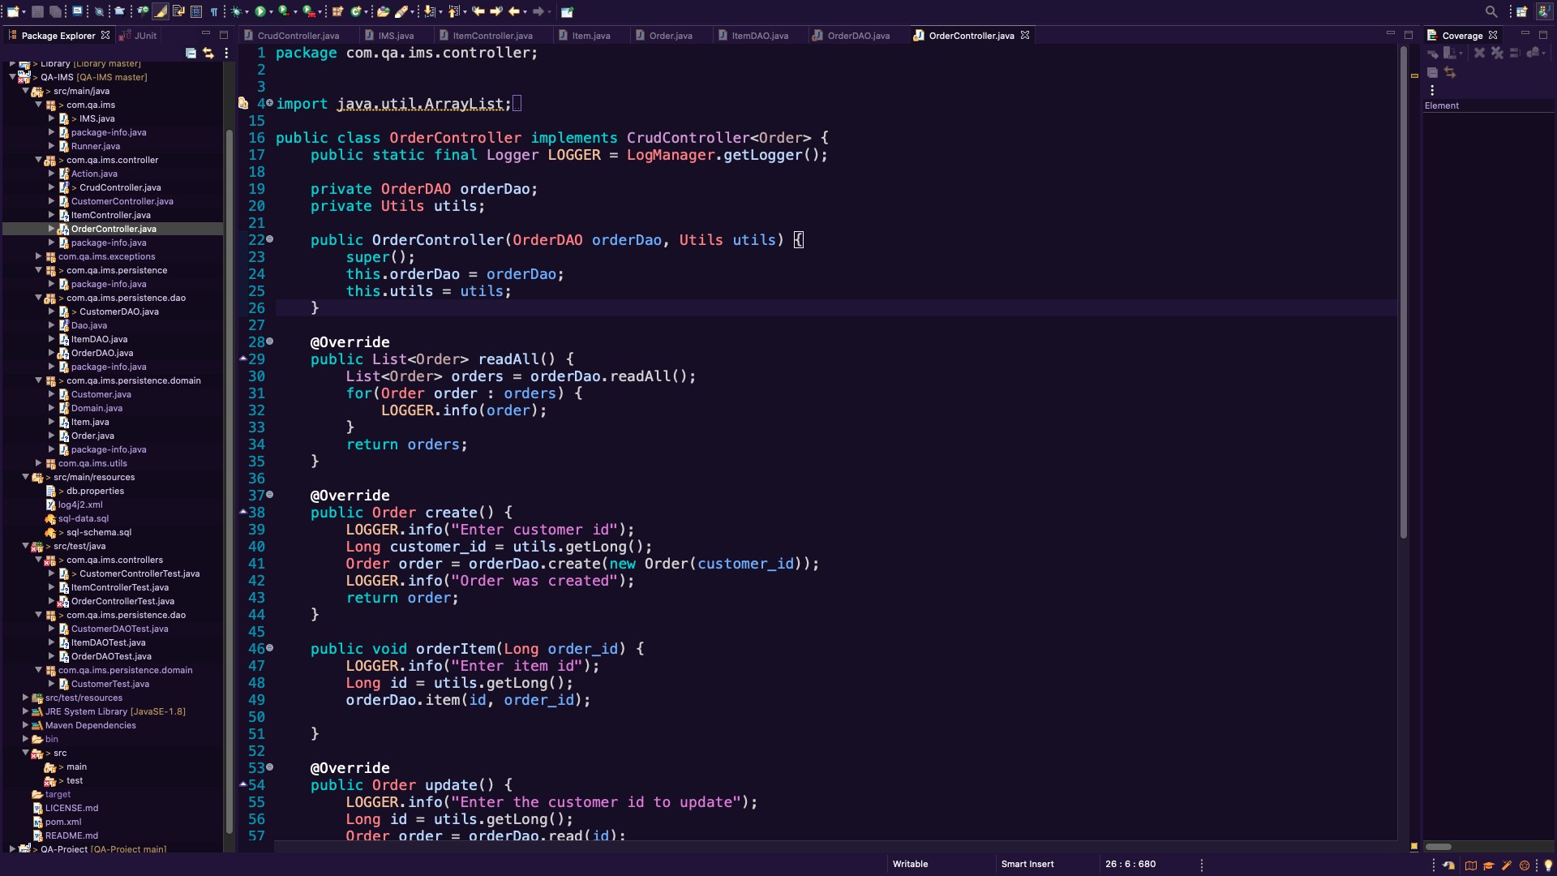
Order Controller
The Order controller interacts with the user and manipulates the Order DAO.

Slide 13
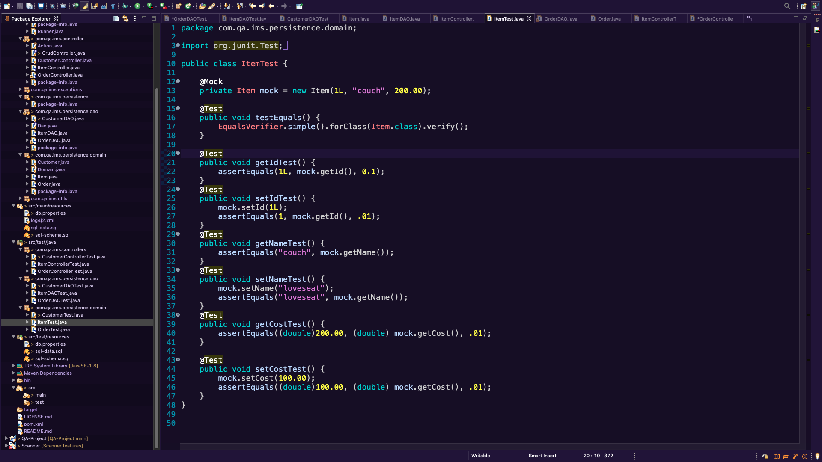
Item Domain Test
All tests passing for Item Domain using junit testing.

Slide 14
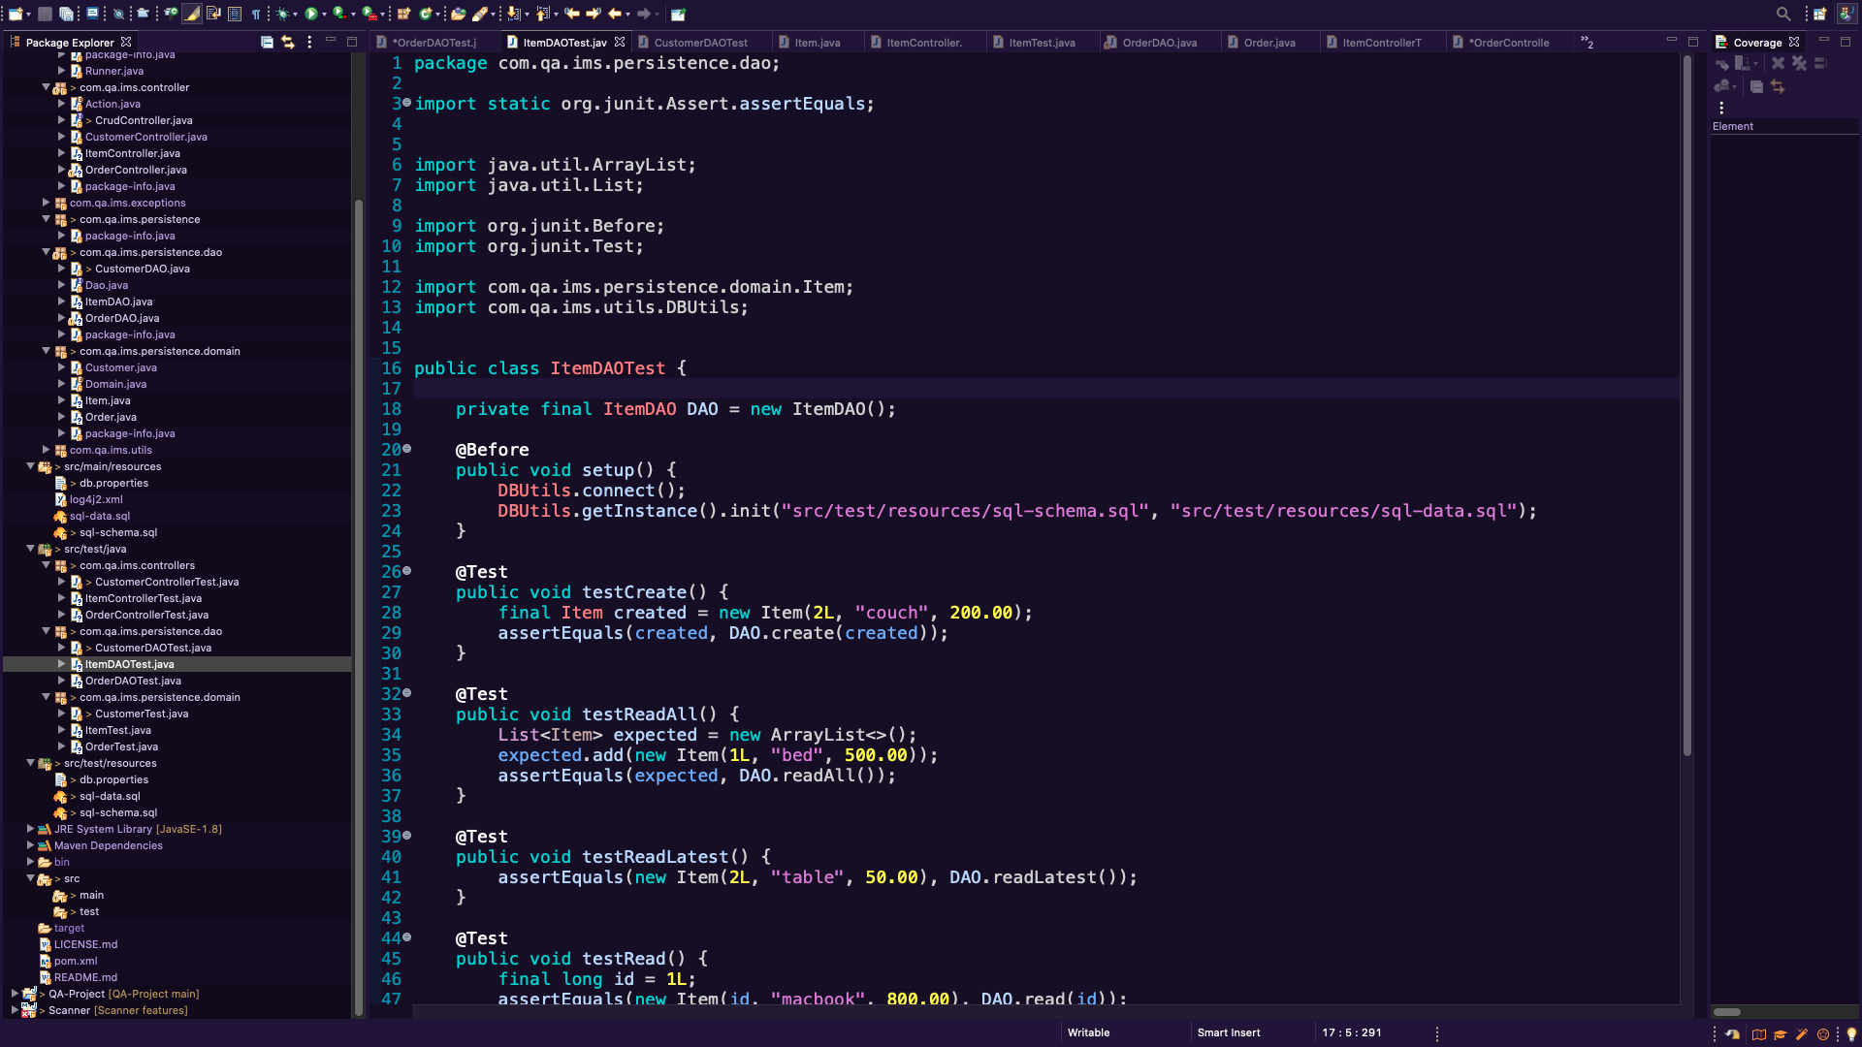
Item DAO Test
I am having errors with the DAO testing so far I have not gotten these tests to pass.

Slide 15
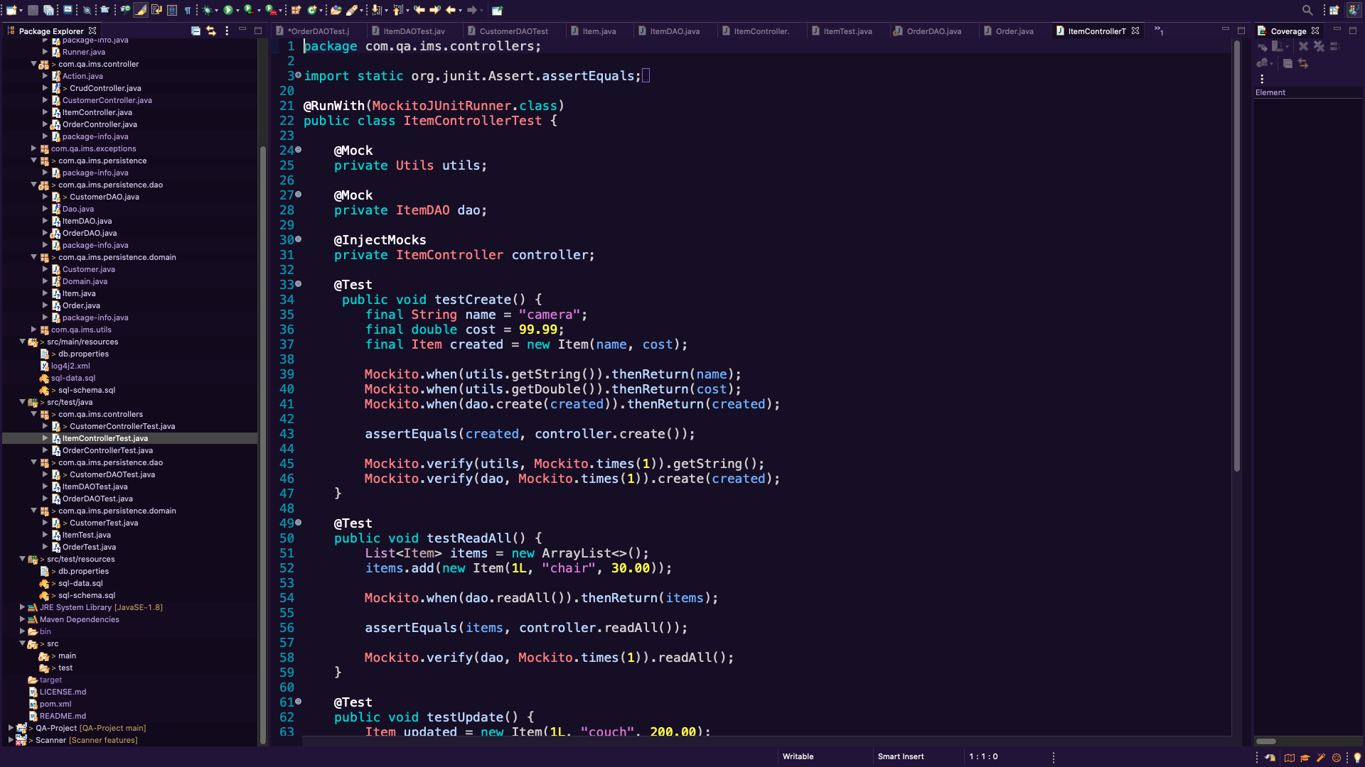
Item Controller Test
All tests passing for Item Controller Test, using Mockito.

Slide 16
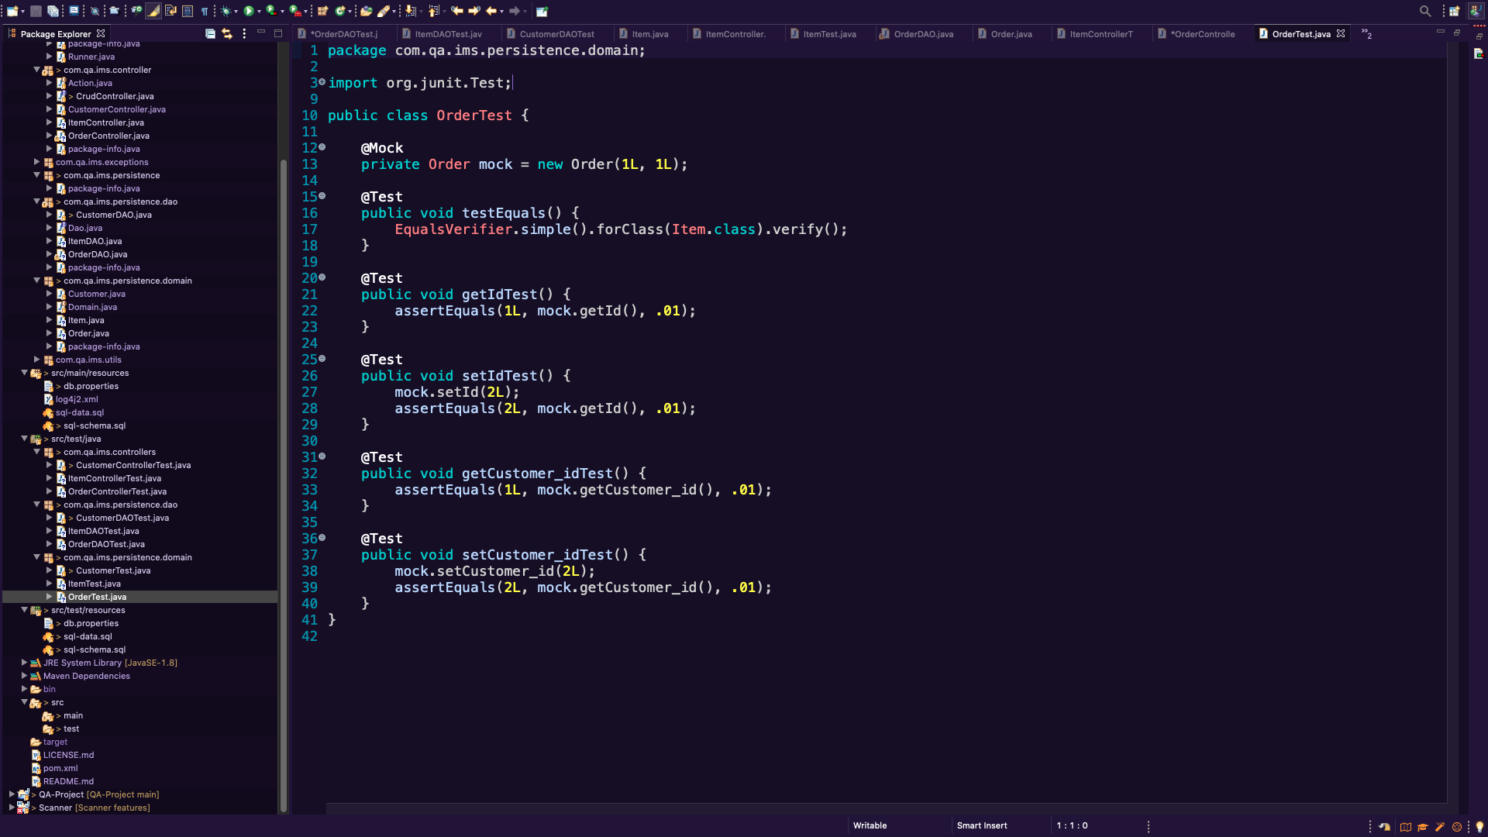
Order Domain Test
All tests passing for Item Domain using junit testing.

Slide 17
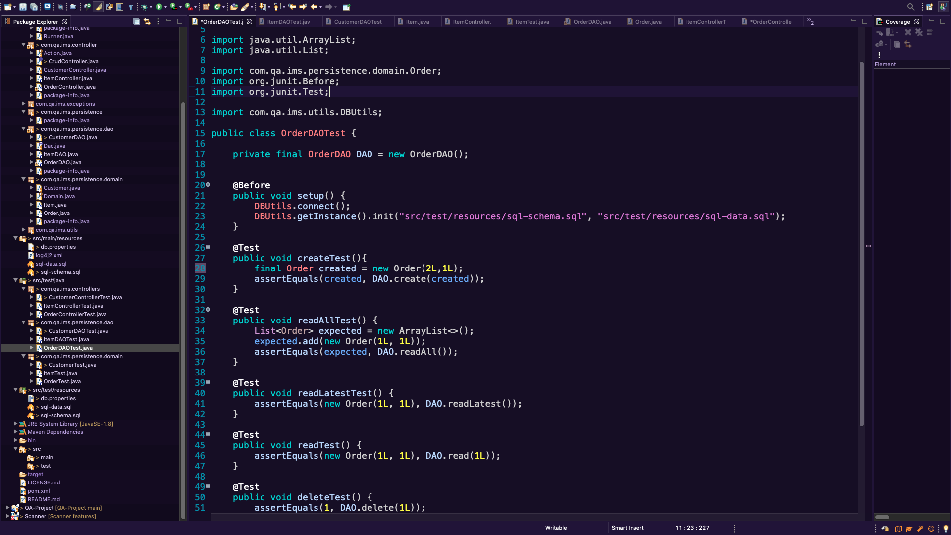
Order DAO Test
I am having errors with the DAO testing so far I have not gotten these tests to pass.

Slide 18
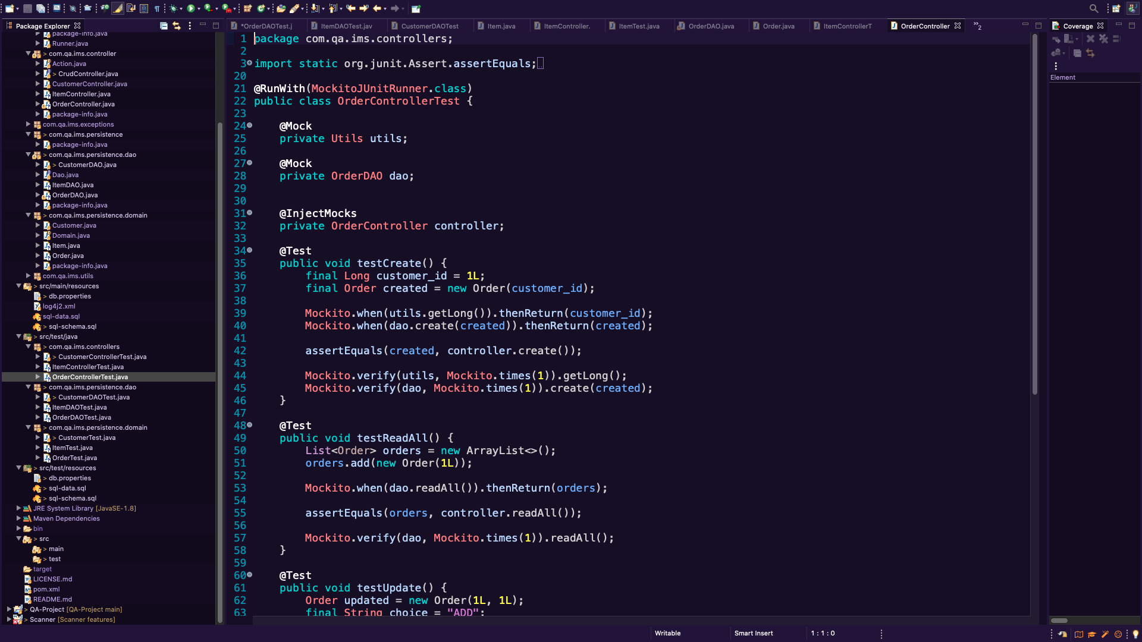
Order Controller Test
All tests passing for Order Controller Test, using Mockito.

Slide 19
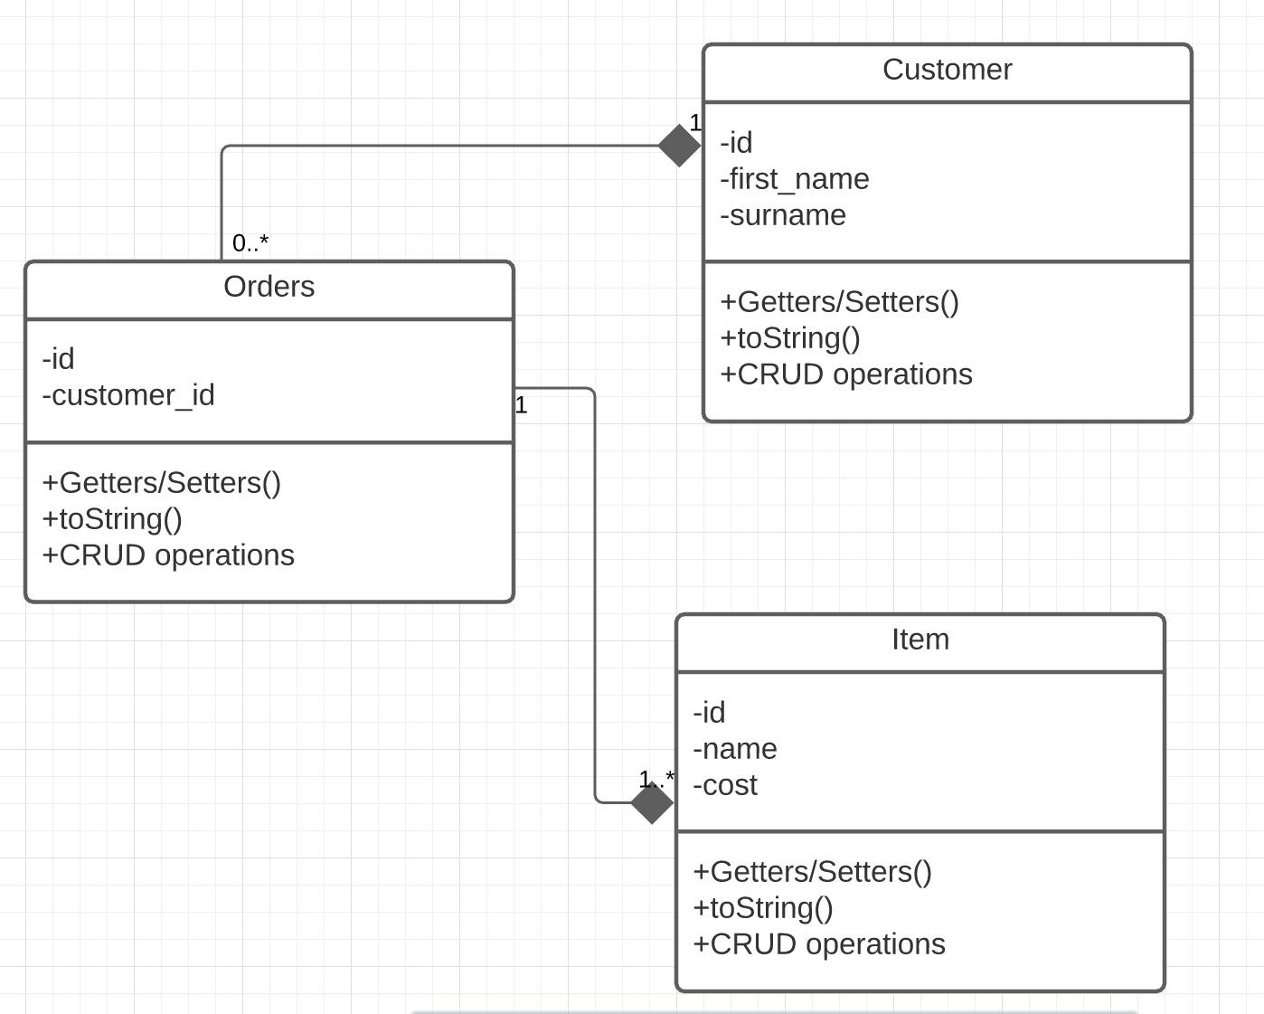
IMS UML
A UML(Unified Modeling Language) is a type of status structure diagram that describes the structure of a system by showing the system's classes, their attributes, operations(or methods), and relationships between objects.
The - indicates that these variables are private,
The grey diamond indicates composition- restricted form of Aggregation in which two entities(classes) are highly dependent on each other.
The numbers represent multiplicity
Orders must know about 1 object in Customer,
Customer may know about many objects in Orders.
Orders must know about atleast 1 object in Items,
Items must know about a single object in Orders.

Slide 20
Questions?
This concludes my presentation of the IMS project.
Thank you for taking the time to view my presentation.

